Slide 1
C - Constants and Literals

Slide 2
Constants refer to fixed values that the program may not alter during its execution. These fixed values are also called literals.
Constants can be of any of the basic data types like an integer constant, a floating constant, a character constant, or a string literal. There are enumeration constants as well.
Constants are treated just like regular variables except that their values cannot be modified after their definition.

Slide 3
Integer Literals
An integer literal can be a decimal, octal, or hexadecimal constant.
A prefix specifies the base or radix: 0x or 0X for hexadecimal, 0 for octal, and nothing for decimal.
An integer literal can also have a suffix that is a combination of U and L, for unsigned and long, respectively.
The suffix can be uppercase or lowercase and can be in any order.

Slide 4
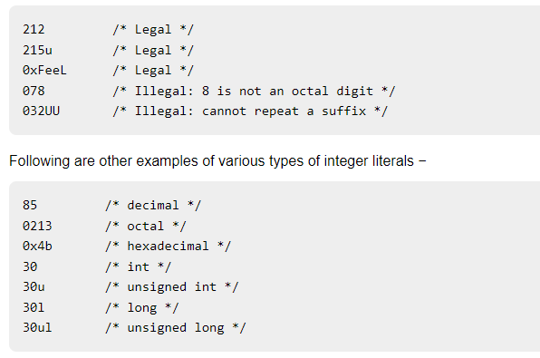

Slide 5
Floating-point Literals
A floating-point literal has an integer part, a decimal point, a fractional part, and an exponent part. You can represent floating point literals either in decimal form or exponential form.
3.14159 /* Legal */
314159E-5L /* Legal */
510E /* Illegal: incomplete exponent */
210f /* Illegal: no decimal or exponent */
.e55 /* Illegal: missing integer or fraction */

Slide 6
Character Constants
Character literals are enclosed in single quotes, e.g., 'x' can be stored in a simple variable of char type.
A character literal can be a plain character (e.g., 'x'), an escape sequence (e.g., '\t').

Slide 7
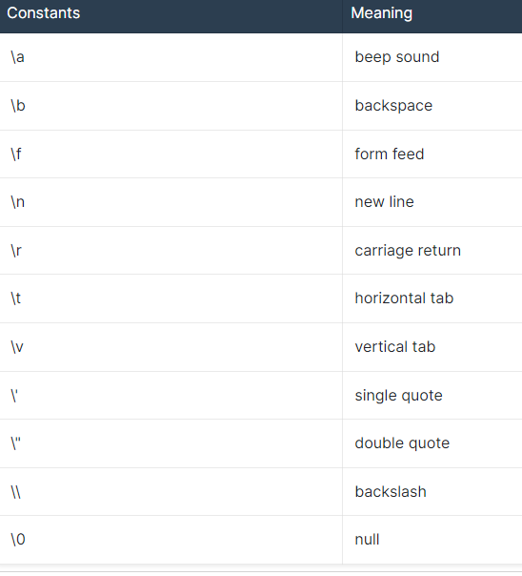

Slide 8
#include <stdio.h>
int main() {
printf("Hello\tWorld\n\n");
return 0;
}
When the above code is compiled and executed, it produces the following result −
Hello World

Slide 9
String Literals
String literals or constants are enclosed in double quotes "".
A string contains characters that are similar to character literals: plain characters, escape sequences, and universal characters.
You can break a long line into multiple lines using string literals and separating them using white spaces.
Here are some examples of string literals. All the three forms are identical strings.
"hello, dear"
"hello, \

Slide 10
Defining Constants
There are two simple ways in C to define constants −
Using #define preprocessor.
Using const keyword.

Slide 11
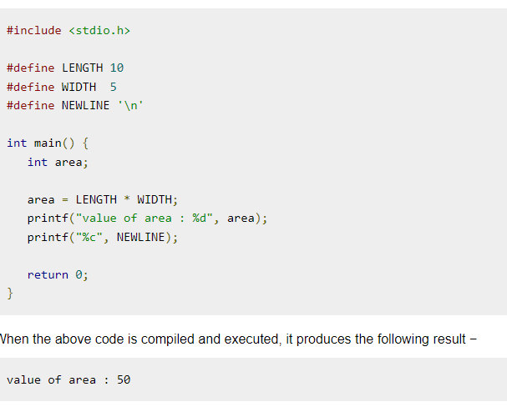
The #define Preprocessor
Given below is the form to use #define preprocessor to define a constant −
#define identifier value

Slide 12
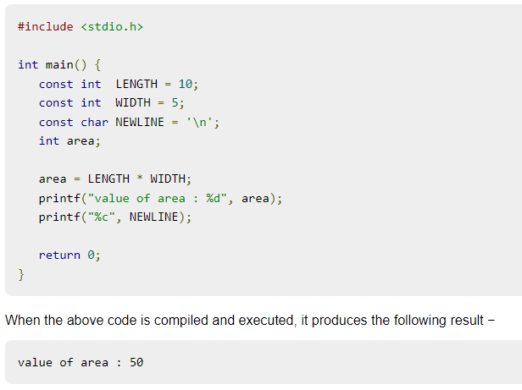
The const Keyword
You can use const prefix to declare constants with a specific type as follows −
const type variable = value;

